Slide 1
Neighborhood Associations
Purposes and Best Practices
Eric King
City Manager
February 7, 2015

Slide 2
Neighborhood Association Budgets
Notes:
A lot of work
See this retreat as an opportunity to get going
We appreciate the cooperation of the neighborhoods during the recession- you helped share in the cuts
Budget- resources added back to pre-recession levels

Slide 3
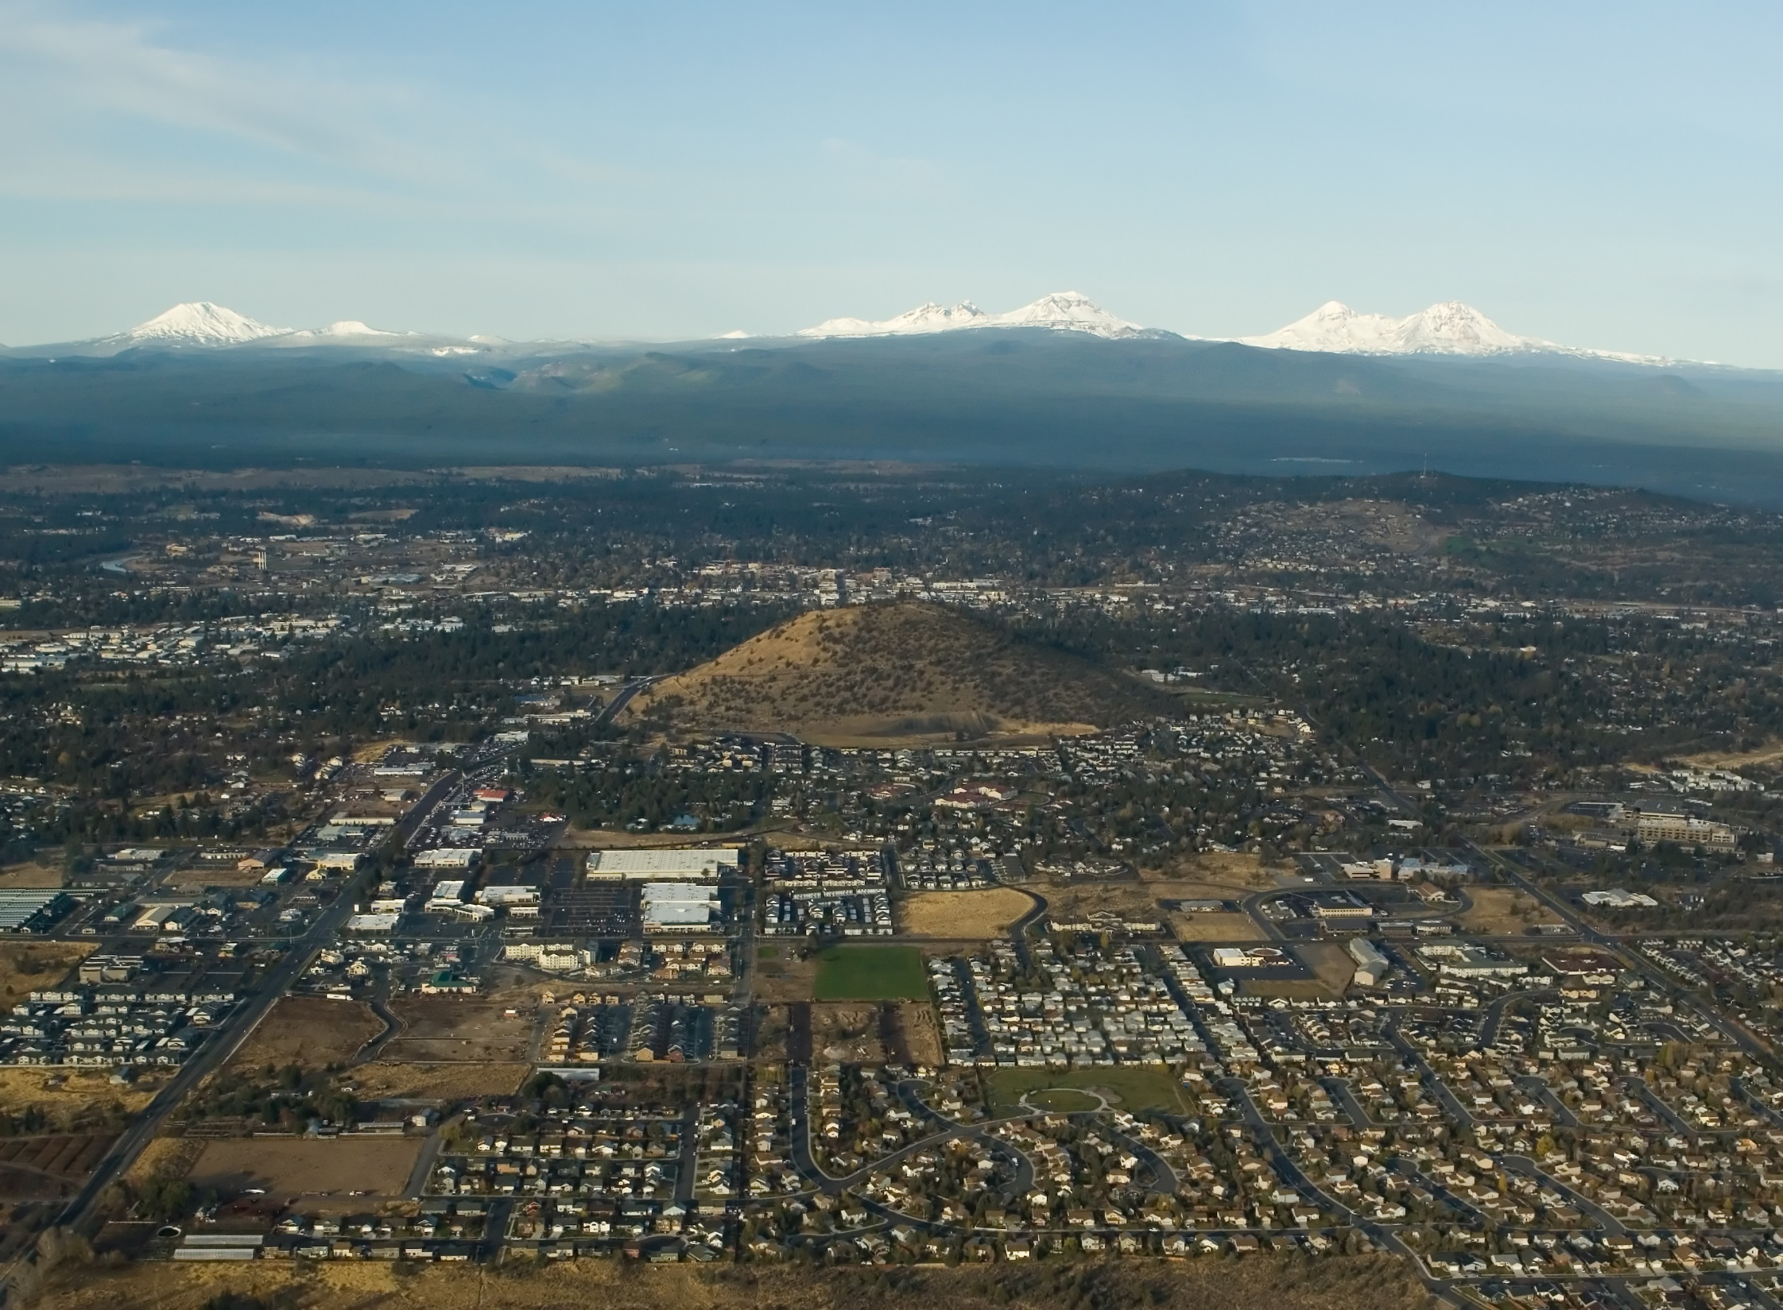
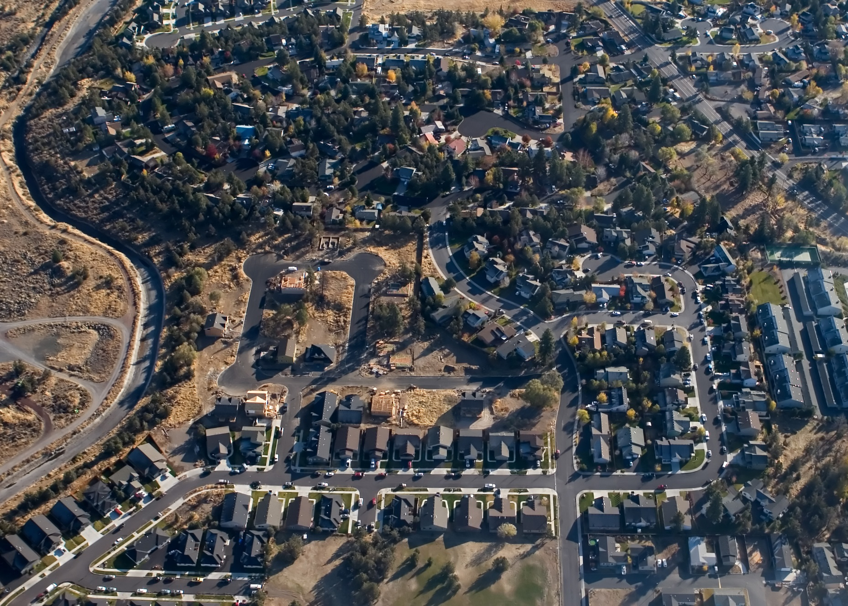
Challenges and Changes
Photo: ©2008 Dustin Mitsch / Alpen Exposure
Notes:
2) We have some significant challenges facing us as an organization, including:
UGB
Siting of OSU
Vacation Rentals
Compatability with businesses and neighborhoods
Noise
Special Events
Funding for street maintenance, transit, and other Transportation Projects
Affordable Housing
Sewer work through existing neighborhoods
Housing affordability
Positioning the City for the new economy, increased diversification
Financial constraints
Look for more partnerships
Story describing that City focused on big picture land use and infrastructure planning
Catch up to the growth
Tough choices in surfacing many of the infrastructure challenges
Now attention focus on neighborhood livability
City will fill in
Demographics are changing- people don't want to be tied down to home ownership

Slide 4
Notes:
3) Purpose- in my words
Role as partner, advisor and collaborator
Generate future civic leaders
Gives people practice in building shared values- tough work
Leads to better decision making
Community involvement
Words of Advice
Land Use is not the only tool
Events are key- National Night Out
Community building occurs at all levels- not just hot button issues
Working with under-represented groups
Key to survival- know your neighbors
Demographic challenges- more diversity on boards

Slide 5
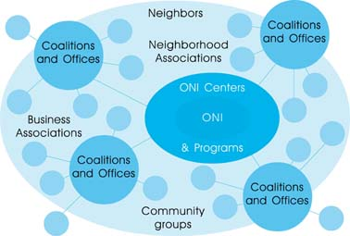
Portland Neighborhood Involvement
Notes:
4) Case Study- Portland Model
Non-profitt involvement, mediation services
Livability Partners

Slide 6
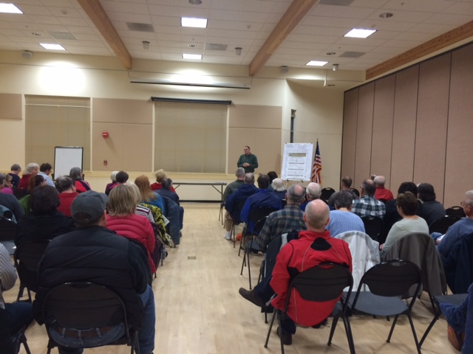
Connect – Community - Council
Larkspur Neighborhood Association
Notes:
5) Lessons on how best to interact with City government
Don't side swipe council
Staff love to present- we are proud- happy to do this- what are you interested in
Help build community
Connect with City Departments
Strategy- biggers sense of the organization
Council Goals- end the presentation with that effort
Don't just bring us problems
Find ways for you to "hang" your projects on the Council goals
To make this work, needs to be coordinated
You are problem solvers
Ask
What do you need from us to make this better for you?
Building budget- restoring funds for communication

Slide 7
Questions?

